Slide 1
Capstone Project The battle of neighbourhoods
Finding yourself a better place

Slide 2
INTRODUCTION
The purpose of this capstone project is to help people in exploring better facilities around their desired neighbourhood.
It will help people making smart and efficient decision on selecting great neighbourhood of their choice in Scarborough, Toronto.
Numerous people are migrating to various states of Canada and need lots of basic research to find the optimal neighbourhood as per their convenience.
This project’s aim to create an analysis of required features for people migrating to Scarborough, Toronto to find the optimal neighbourhood.
The features would range from housing prices to crime rates, nearby hangout places to basic institutions and lots more.

Slide 3
TARGET Audience
Fresh immigrants to Canada.
People shifting to different state within Canada.
People who want to explore their neighborhood to look for various options.

Slide 4
DATA SECTION
Data Link: https://en.wikipedia.org/wiki/List_of_postal_codes_of_Canada:_M
I will use Scarborough dataset which is scrapped from Wikipedia.
Dataset consisting of latitude and longitude, zip codes.
Foursquare API data

Slide 5
FOURSQUARE API
Foursquare is a location data provider with information about all manner of venues and events within an area of interest.
Such information includes venue names, locations, menus and even photos.
As such, the foursquare location platform will be used as the sole data source since all the stated required information can be obtained through the API.

Slide 6
FOURSQUARE API DATA
The data retrieved from Foursquare contained information of venues within a specified distance of the longitude and latitude of the postcodes. The information obtained per venue as follows:
Neighbourhood
Neighbourhood Latitude
Neighbourhood Longitude
Venue
Name of the venue e.g. the name of a store or restaurant
Venue Latitude
Venue Longitude
Venue Category

Slide 7
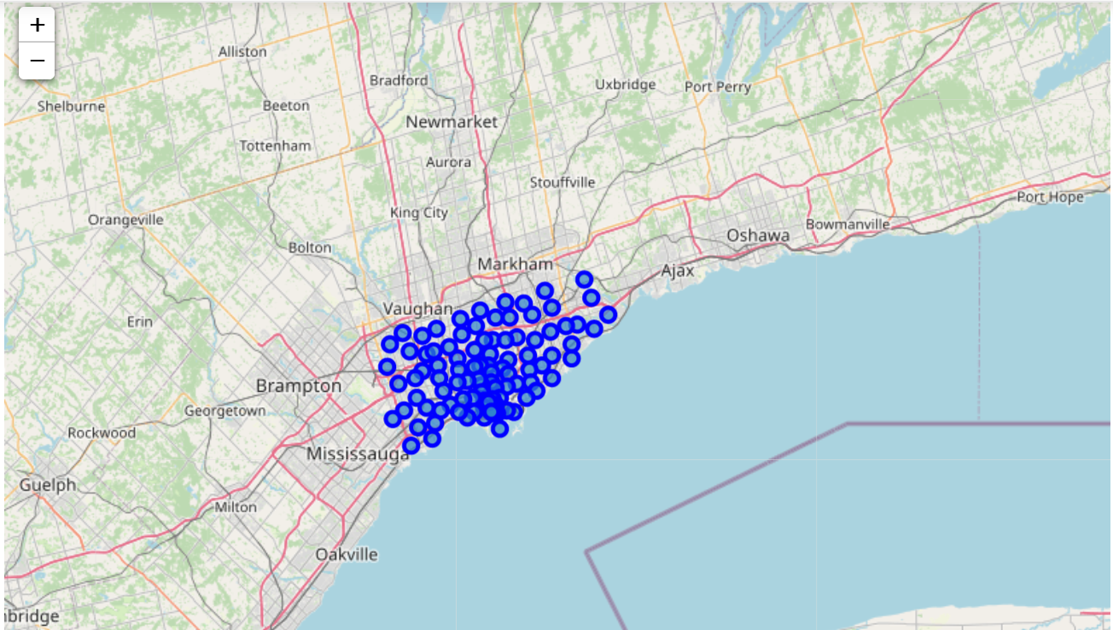
Map of Scarborough

Slide 8
METHODOLOGY
Clustering Approach:
To compare the similarities of two cities, we decided to explore neighbourhoods, segment them, and group them into clusters to find similar neighbourhoods in a big city like New York and Toronto.
To be able to do that, we need to cluster data which is a form of unsupervised machine learning: k-means clustering algorithm.

Slide 9
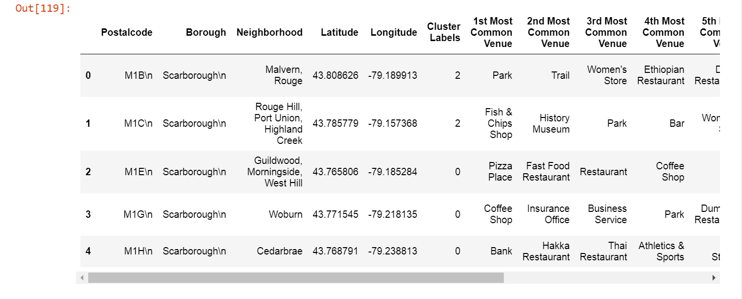
K-MEANS CLUSTERING

Slide 10
WORKFLOW
Using credentials of Foursquare API features of near-by places of the neighbourhoods would be mined.
Due to http request limitations the number of places per neighbourhood parameter would reasonably be set to 100 and the radius parameter would be set to 500.

Slide 11
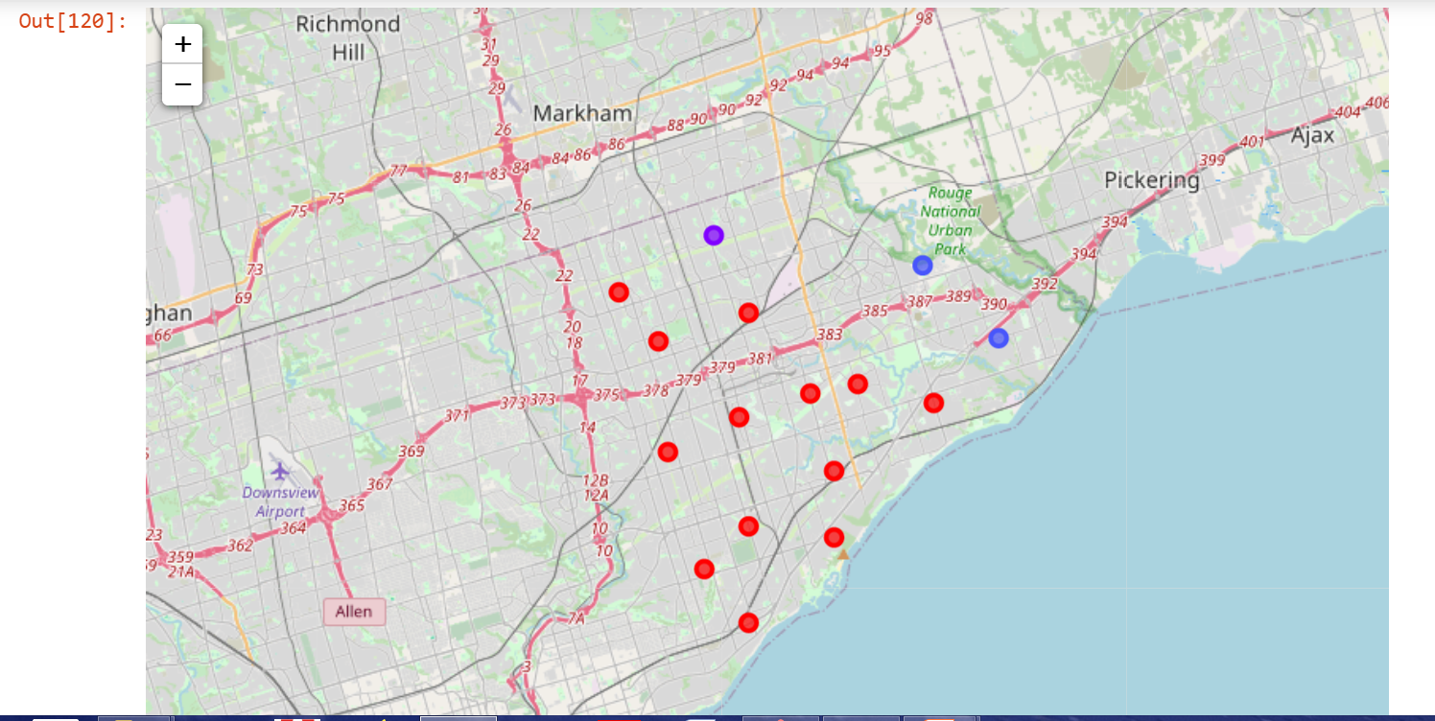
RESULTS-Map of clusters in Scarborough

Slide 12
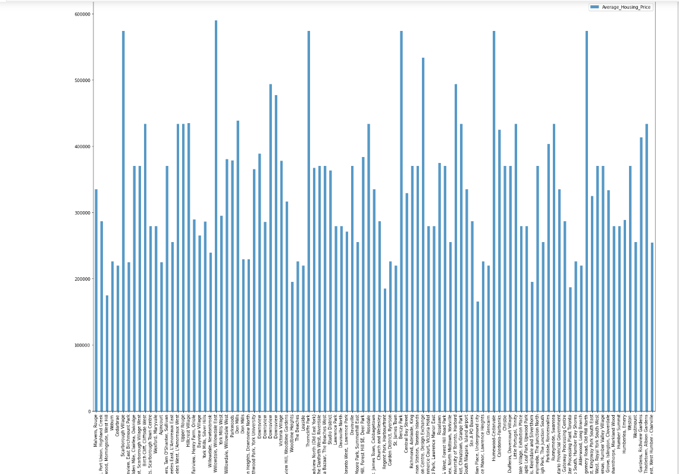
RESULTS- Average Housing Price by Clusters in Scarborough

Slide 13
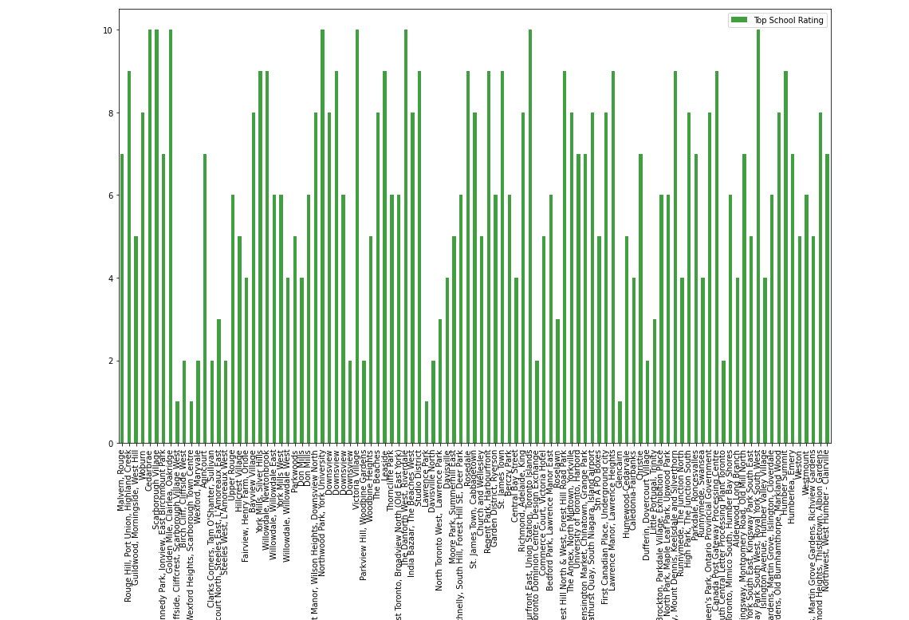
RESULTS- School Ratings by Clusters in Scarborough

Slide 14
DISCUSSION
The major purpose of this project, is to suggest a better neighbourhood in a new city for the people who are shifting there. Connectivity to the airport, bus stand, city centre markets and other daily needs nearby.
Sorted list of house in terms of housing prices in a ascending or descending order
Sorted list of schools in terms of location, fees, rating and review

Slide 15
CONCLUSION
In this Capstone project, using k-means cluster algorithm I separated the neighbourhood into 10(Ten) different clusters and for 103 different latitude and longitude from dataset, which have very-similar neighbourhoods around them.
Using the charts above results for a particular neighbourhood based on average house prices and school rating have been made.

Slide 16
LIBRARIES USED
Pandas: For creating and manipulating dataframes.
Folium: Python visualization library would be used to visualize the neighbourhoods cluster distribution of using interactive leaflet map.
Scikit Learn: For importing k-means clustering.
JSON: Library to handle JSON files.
XML: To separate data from presentation and XML stores data in plain text format.
Geocoder: To retrieve Location Data.
Beautiful Soup and Requests: To scrap and library to handle http requests.
Matplotlib: Python Plotting Module

